Slide 1

SURGE PROTECTION
Every electrical device has a specific dielectric strength. If the level of a surge voltage exceeds this strength, malfunctions or damage can occur. Surge voltages in the high or kilovolt range are generally transient over voltages of comparatively short duration. They generally last from a few hundred microseconds to a few milliseconds. As the maximum amplitude of such transients can amount to several
kilovolts, steep voltage increases and differences are often the consequence. Surge protection is the only thing that helps.
Telecommunication end devices are today an inherent part of office electronics. Today, unrestricted operational availability of modern, fast communication systems is an absolute necessity, especially in the business sector. The specific use of suitable surge protective devices can prevent the sudden and unforeseen failure of important telecommunications equipment. Suitable protective devices for DSL data transmission and for analog signal interfaces are available.
The protective circuit is mainly made up of a combination of Trisil diodes and powerful, gas-filled surge protective devices. The gas-filled surge protective devices are designed as three-electrode gas discharge tubes. The central electrode provides common mode voltage protection on the ground
To protect against voltages from the power supply network (power cross) the three-electrode gas discharge tubes are equipped with thermal protection

Slide 2
DATA SURGE PROTECTION
Ethernet and token ring interfaces have been used for years. Ethernet systems have prevailed, however, due to their transmission speed and compact connectors. The transmission behavior of the Ethernet system is defined in standard IEEE 802.3. The transmission speed is up to 10 Gbps. The transmission speed (Table 5.1.1a) is defined according to the power categories (Cat. 5 - Cat. 7). New systems with a higher transmission frequency work according to cat6,and Cat 7 and in the future
will work according to Cat. 8.1 or Cat. 8.2. Protective devices with RJ45 connection, where all eight signal paths are protected, are universally suited to the Ethernet, Profinet, and token ring interface
The interfaces operate with low signal levels at high frequencies. This makes them particularly sensitive to surge voltages and can lead to the destruction of electronic components in IT systems. In addition to protection that is tailored to these systems, SPDs must also exhibit high-quality signal transmission behavior, as otherwise malfunctions are to be expected in the data transmission. This aspect is becoming ever more important in the face of constantly increasing data transmission rates. To this end, when developing new SPDs for IT systems, the focus is on implementing high-quality signal transmission behavior. It is evaluated based on the ISO/IEC 11801 or EN 50173 standards
Protective devices with RJ45 connection, where all eight signal paths are protected, are universally suited to the Ethernet, Profinet, and token ring interfaces
Power over Ethernet (PoE) is a process in which the auxiliary energy for the connected devices is also transmitted via the Ethernet data cable. The auxiliary power is either applied to the unused wire pair (mode b, Fig. 86) or is supplied between the signal wire pairs as phantom power (mode A, Fig. 85). In line with IEEE 802.3af, a maximum power of 13.5 W can be transmitted using this procedure. The following IEEE 802.3at standard already enables 25.5 W with PoE. POE++ is being debated, with which even higher transmission capacities will be able to be achieved.

Slide 3
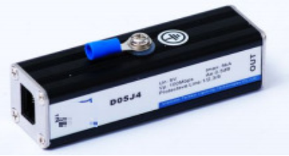

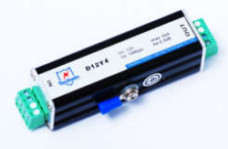
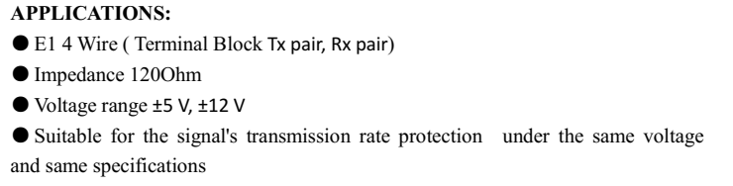
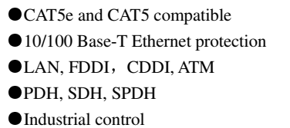
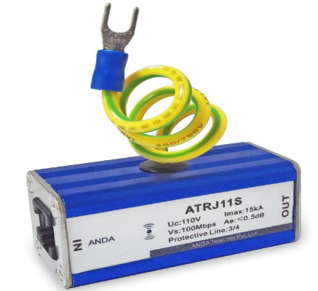

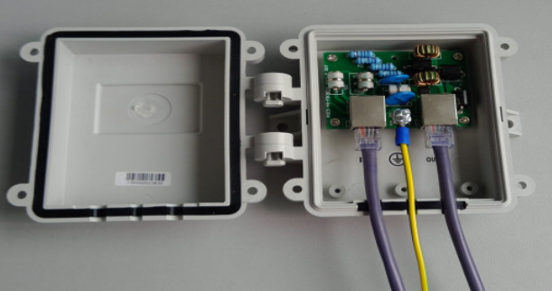
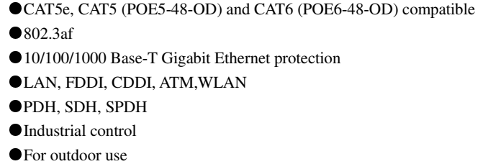
TYPES OF DATA LINE SURGE PROTECTION-1
Model: ATRJ11S
APPLICATIONS:
Designed for Audio device not to be spoiled by lightning over-voltage, induced over-voltage and static discharge.
●Telephone, Fax,
●ISDN, DDN, DSL
●Broadcast system

Slide 4
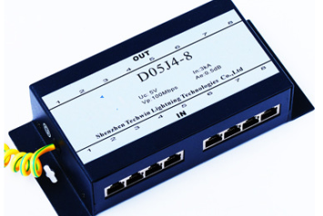

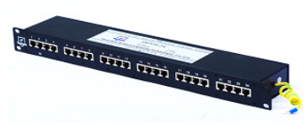
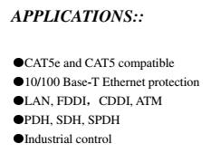
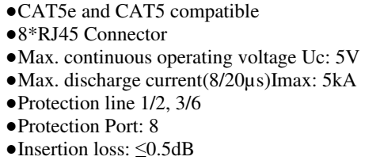
TYPES OF DATA LINE SURGE PROTECTION-2

Slide 5

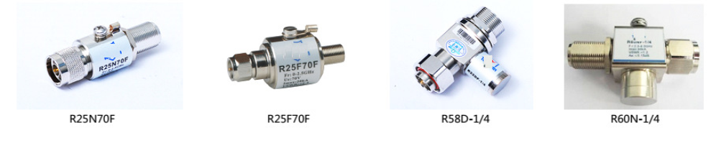
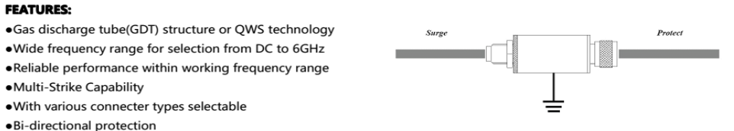
TYPES OF SIGNAL TRANSMISSION PROTECTION
Antenna cables which extend beyond the building and are generally particularly long, as well as the antennas themselves, are directly exposed to atmospheric discharges. For this reason, cables with a coaxial structure and therefore favorable EMC properties are used. The shield of the antenna cable can be either grounded or floating, depending on the system conditions. However, the risk of surge voltage coupling in antenna cables is not completely eliminated. Surge voltages can even reach the sensitive interfaces of transceiver systems via this cable path.
The high frequencies of wireless transmission require the use of protective devices with low self capacitance or low insertion loss with good impedance matching
However, it must be taken into account that the cable that is connected to the Lambda/4-protective device cannot use a DC power supply. Relatively wide bandwidth signals (e.g., 0.8 – 2.25 GHz) can be transmitted by means of HF-optimized Lambda/4 protective devices. Fig. shows a typical design of a protective device with Lambda/4 technology. The most common applications for SPDs in telecommunications are:

Slide 6
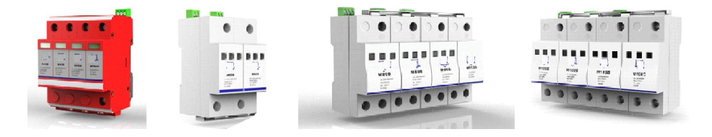

PROTECTION AC SYSTEMS
The lightning protection zone concept provides coordinated surge protective devices for all lines that cross between zones. Their power values are based on the protection class to be achieved. Depending on the zone transition, different types are therefore required (refer to Table ). The requirements for individual SPD types are defined in the product standard for surge protective devices, IEC 61643- 11.
Type 1: lightning current arrester(Type 1 surge protective devices must fulfil the highest requirements in terms of amplitude and specific energy from surge voltages or surge currents, as they are supposed to protect from direct lightning strikes. In the typical installation environment of the main distribution, the demand placed on the short-circuit withstand capability is often very high)
Type 2: surge protective device (Type 2 surge protective devices are generally installed in sub-distributions or machine control cabinets. These SPDs must be able to discharge induced surge voltages from indirect lightning strikes or switching operations but not handle direct lightning strikes. As such, the energy input is significantly reduced. In any case, induced surge voltages caused by switching operations are often very dynamic
Type 3: device protection(Type 3 surge protective devices are generally installed right in front of the terminal device to be protected. Due to differing installation environments, type 3 SPDs are available in a very wide range of designs. For example: in addition to standard DIN rail mounting, there are devices for installation in sockets or for direct mounting on a PCB of the end device. Technologically speaking, type 3 SPDs are most similar to type 2

